Slide 1

HR Analytics Recruitment Analysis by Power BI
Presented by- Sahil Sudhir BhaNdari
Intern id-STB03 – T0031
Guided by- urooj khan

Slide 2

Power-BI
Power BI is a business analytics tool by Microsoft that empowers users to visualize and share insights from their data. With intuitive dashboards, interactive reports, and a user-friendly interface
Power BI empowers users to visualize and analyze data, enabling informed decision-making across organizations

Slide 3
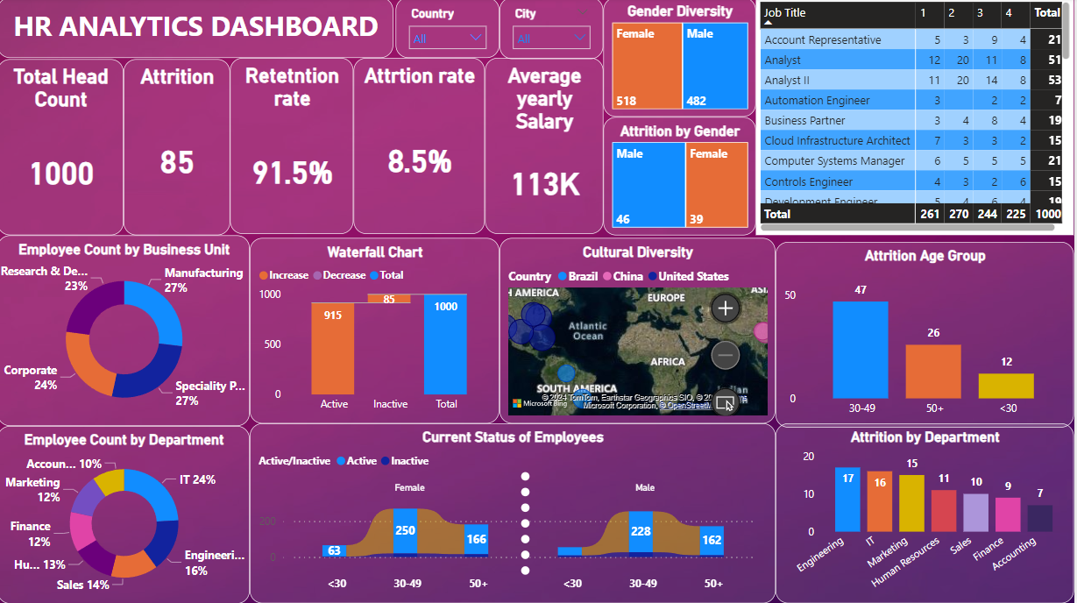
Visualization of Hr Analytics

Slide 4
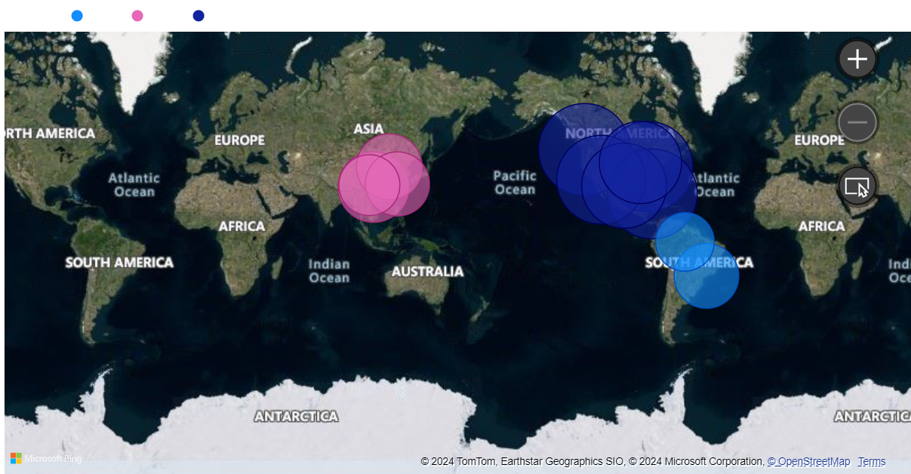
Cultural Diversity

Slide 5
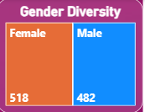
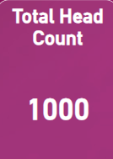
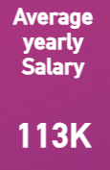
In terms of gender diversity, there are 482 male employees and 518 female employees.
The average salary in the company is $113,000.
The total headcount of the company is 1,000 employees.

Slide 6
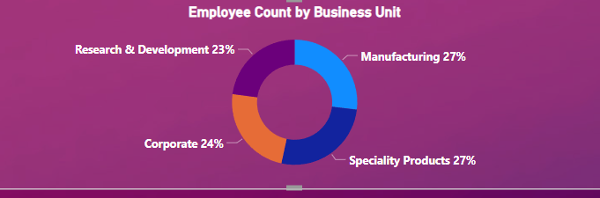
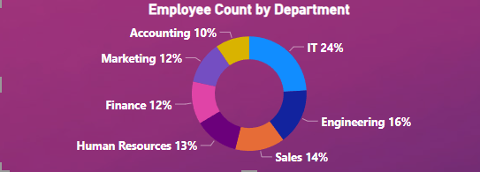
Employee Count

Slide 7
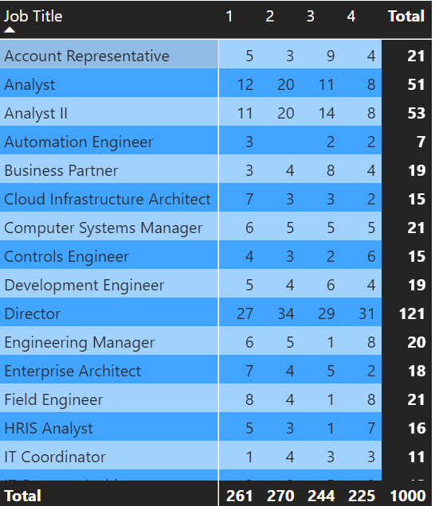
Employee count by job title

Slide 8
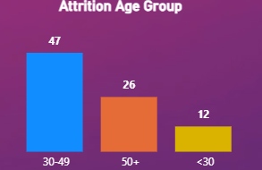
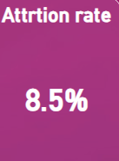
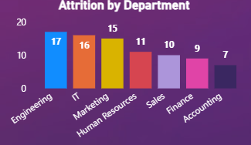
Attrition Count

Slide 9

Thank you!

